Slide 1
Java Unit Testing With Mockito Tips And Tricks
Michael Plüss
Michael Plüss

Slide 2



Technologies
Junit 5
Mockito
Spring

Slide 3
Structure
Techniques:
@Injectmocks
MockedStatic
Spy
@ParametrizedTest
Previews of additional techniques
AssumeThat
Extracting
Each technique:
Short description
Exercise
5 minutes discussion

Slide 4
@InjectMocks
Issues:
Lots of testing constants
Scrolling between constants, tests and mocked services
Solution:
Mock services via @InjectMocks and @Mock
Mock service methods in test method

Slide 5
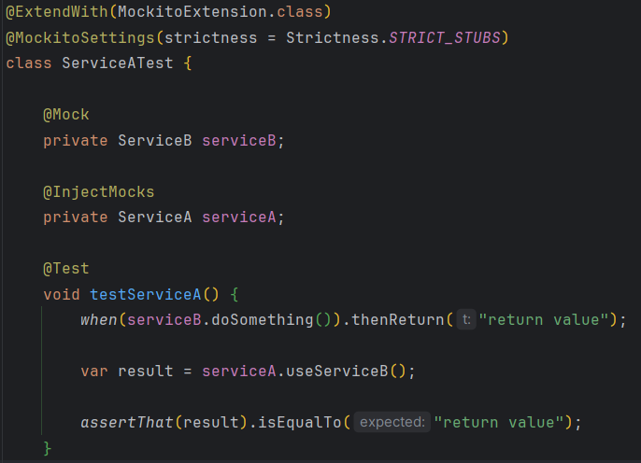
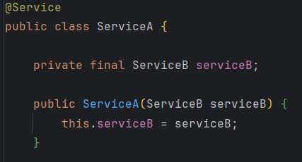
@InjectMocks
Refactor “InjectMocksServiceTest”

Slide 6
@InjectMocks – 5 min discussion
How do you feel about this approach?
Advantages?
Disadvantages?
Alternatives?

Slide 7
MockedStatic
Issues:
Service uses static method (e.g. LocalDateTime.now() )
Solution:
Static methods can be mocked!

Slide 8
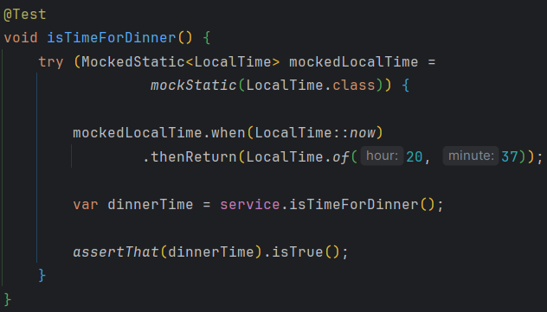
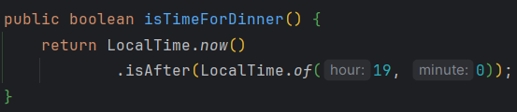
MockedStatic
Refactor “UsesStaticServiceTest”

Slide 9
MockedStatic – 5 min discussion
How do you feel about this approach?
Advantages?
Disadvantages?
Alternatives?

Slide 10
Spy
Issues:
How to test an interface with default methods?
Solution:
Mockito.spy() allows us to test interfaces without implementation

Slide 11
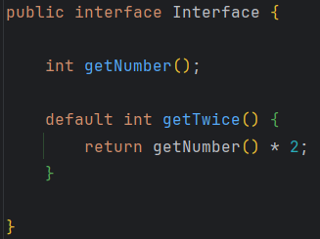
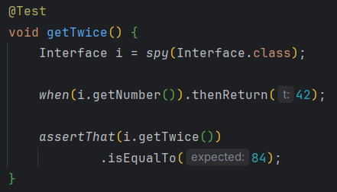
Spy
Refactor “HasHelloInterfaceTest”

Slide 12
Spy – 5 min discussion
How do you feel about this approach?
Advantages?
Disadvantages?
Alternatives?

Slide 13
@ParameterizedTest
Issues:
Method takes a number of parameters
We need to test many different combinations
Solution:
The “table” of parameters and corresponding expected results can be extracted
Separate data and test logic

Slide 14
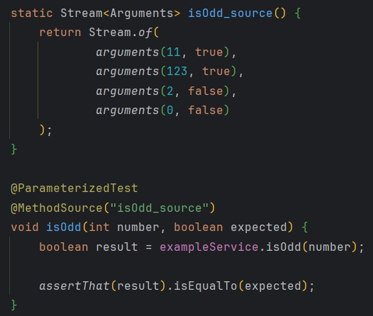
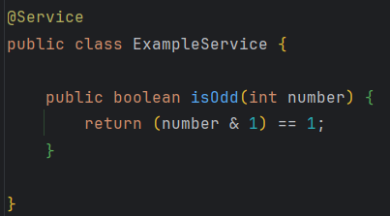
@ParameterizedTest
Refactor “PocketCalculatorTest”

Slide 15
@ParameterizedTest – 5 min discussion
How do you feel about this approach?
Advantages?
Disadvantages?
Alternatives?

Slide 16
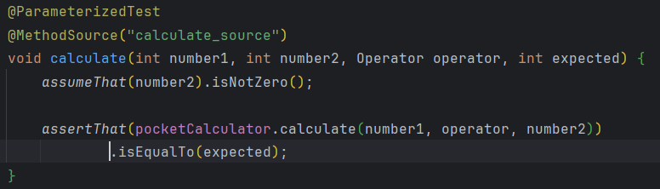
Further Techniques: AssumeThat
Only run a test, if an assumption is fulfilled
Ensure that a generalized test only tests data that makes sense in its context

Slide 17
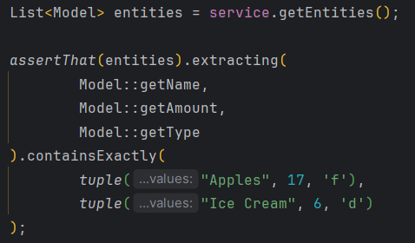
Further Techniques: Extracting
Test various fields at once
Compact testing of lists

Slide 18
Questions & Feedback
& Thank you!

